Slide 1
Customer Churn Prediction by ANN
By Kashif Hussain

Slide 2
Customer Churn Prediction by ANN
Customer Churn Prediction using Artificial Neural Networks (ANN) involves training a neural network model on historical customer data to predict the likelihood of a customer leaving (churning) in the future.
The goal is to identify patterns and factors contributing to customer churn, enabling businesses to take proactive measures to retain customers and improve customer satisfaction.

Slide 3


AGENDA
PROBLEM STATEMENT
PROJECT OVERVIEW
END USERS
SOLUTION
MODELLING
RESULTS
3/21/2024 Annual Review

Slide 4

PROBLEM STATEMENT
The problem aims to develop an Artificial Neural Network (ANN) model for predicting customer churn based on historical data.
This involves designing a system capable of analyzing customer behavior patterns and factors contributing to churn, aiming to accurately forecast which customers are likely to leave in the future.

Slide 5

PROJECT OVERVIEW
Customer Churn Prediction using Artificial Neural Networks (ANN) involves training a neural network model on historical customer data to predict the likelihood of a customer leaving (churning) in the future.
This project typically involves preprocessing the data, designing the architecture of the neural network, training the model using techniques like backpropagation, and evaluating its performance using metrics such as accuracy, precision, recall, and F1-score
DATASET USED: telco_customer_churn

Slide 6

WHO ARE THE END USERS?
Business Executives: Executives and decision-makers who use the churn prediction insights to strategize and allocate resources effectively, enhancing customer retention efforts and maximizing revenue.
Customer Relationship Management (CRM) Teams: CRM teams utilize churn predictions to identify at-risk customers, personalize interactions, and implement retention campaigns tailored to individual customer needs, aiming to improve overall customer satisfaction and loyalty.
Marketing Teams: Marketing teams leverage churn predictions to optimize targeted marketing efforts, focusing on retaining high-value customers and re-engaging potentially churn-prone segments with tailored messaging and offers.

Slide 7
WHO ARE THE END USERS?
Customer Support Teams: Customer support teams can proactively address customer concerns and issues, preventing churn by offering timely assistance and resolving problems before they escalate, thus fostering positive customer experiences.
Product Development Teams: Product development teams utilize churn prediction insights to identify pain points and areas for improvement in products or services, guiding future development efforts to better meet customer expectations and reduce churn risk.

Slide 8

YOUR SOLUTION AND ITS VALUE PROPOSITION
The solution for the Customer Churn Prediction project involves developing an Artificial Neural Network (ANN) model trained on historical customer data to accurately forecast potential churners.
Its value proposition lies in providing businesses with actionable insights to proactively identify and retain at-risk customers, thereby reducing customer attrition, increasing customer lifetime value, and ultimately enhancing profitability through targeted retention strategies.

Slide 9

THE WOW IN YOUR SOLUTION
The wow factor in the Customer Churn Prediction solution lies in its ability to leverage advanced Artificial Neural Network to analyze complex patterns and subtle indicators of customer behavior, enabling highly accurate predictions of churn.
By harnessing the power of machine learning, businesses can not only anticipate churn but also deploy proactive retention strategies, fostering long-term customer relationships and sustainable growth.
3/21/2024 Annual Review

Slide 10
MODELLING
Data Collection: Gathered historical customer data from telco_customer_churn
The dataset consists of 7043 rows and 21 columns, where rows represent the number of customers in the dataset and the columns represent each customer’s attribute. The attributes are used to predict the churn of a particular customer.
Data Preprocessing: Cleaned the data, handle missing values, encode categorical variables, and scale numerical features to prepare the dataset for training.
Model Selection: Chose an appropriate ANN architecture for customer churn prediction, considering factors such as the number of hidden layers, activation functions, and optimization algorithms.

Slide 11
MODELLING
Training: Trained the ANN model using the preprocessed data, utilizing techniques like backpropagation and gradient descent to minimize the loss function.
Deployment: Deploy the trained ANN model into production, integrating it into the business workflow to provide real-time predictions of customer churn.
Monitoring and Maintenance: Continuously monitor the model's performance and update it as needed with new data to ensure its effectiveness in predicting customer churn over time.

Slide 12
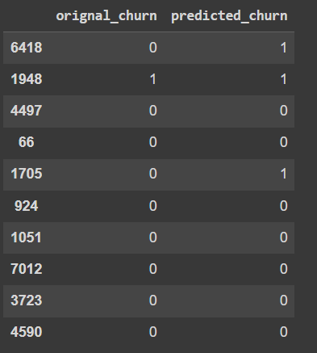
RESULTS

Slide 13
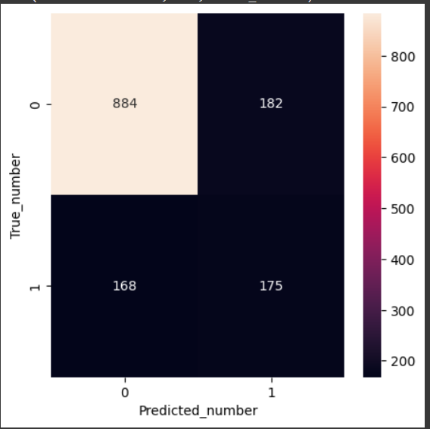
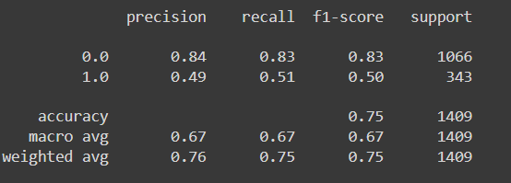
RESULTS

